Slide 1

Datathon 2024
Evaluating the performance of GPT-4o on Korean Medical Licensing Examinations using both text and image data
2024. 06. 23.
^{Team J name: Bias, by us!}
김혜진, Hyejin Kim
윤준, Jun Yoon
윤진식, Jinsik Yoon
윤태웅, Taewoong Yoon
장보아, Boa Jang
한창호, Changho Han

Slide 2
Datathon 2024
Evaluating the performance of GPT-4o on Korean Medical Licensing Examinations using both text and image data
(+ possible bias perpetuated in GPT-4o)
2024. 06. 23.
^{Team J name: Bias, by us!}
김혜진, Hyejin Kim
윤준, Jun Yoon
윤진식, Jinsik Yoon
윤태웅, Taewoong Yoon
장보아, Boa Jang
한창호, Changho Han

Slide 3
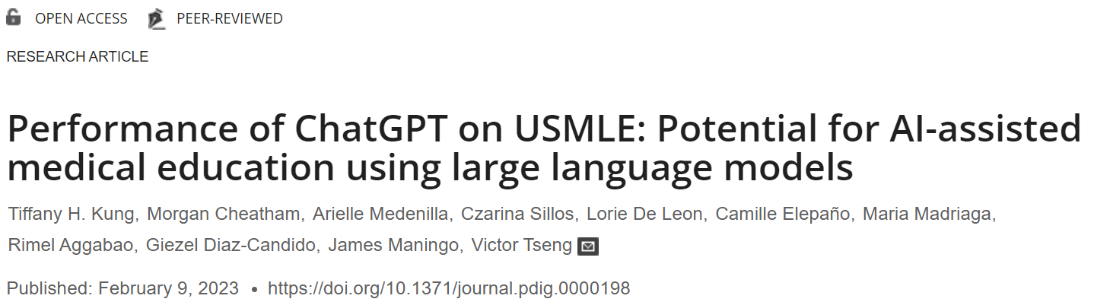
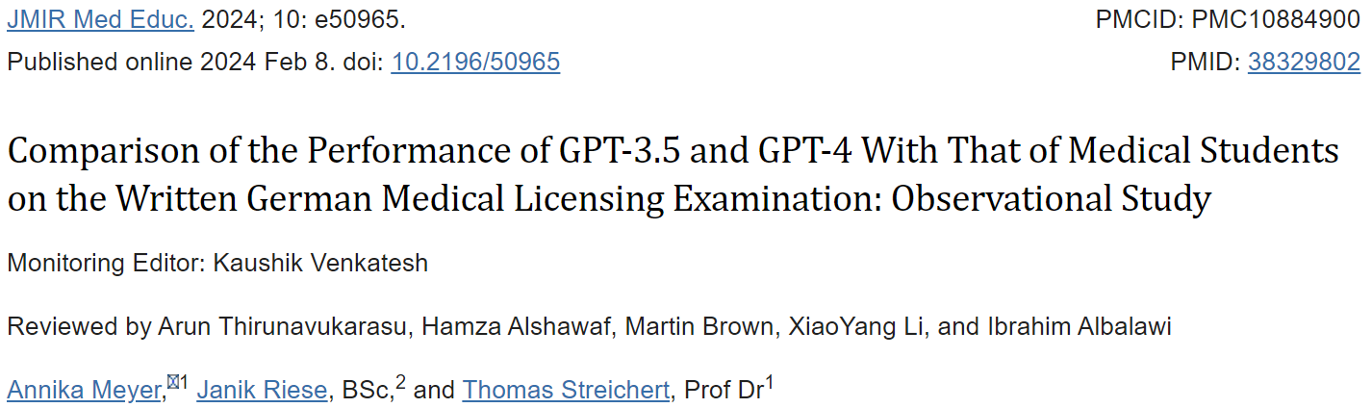
Introduction
Background

Slide 4
Introduction
Background
GPT-4o : Multimodal model has been introduced
There are no studies evaluating the performance of LLM on KMLE yet. (in Korean)
There are no studies evaluating the Medical Licensing Examination using GPT-4o yet.

Slide 5
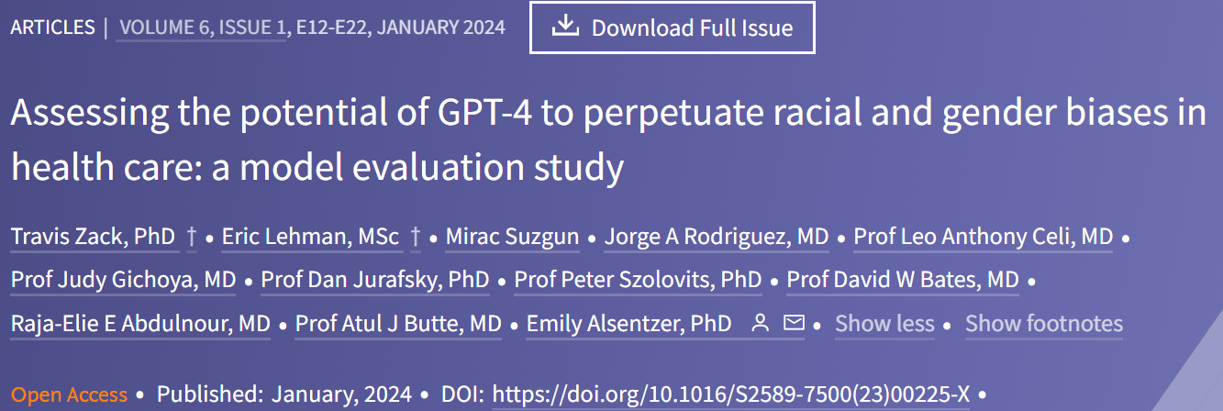
Introduction
Background
GPT-4o : Multimodal model has been introduced
There are no studies evaluating the performance of LLM on KMLE yet.
There are no studies evaluating the Medical Licensing Examination using GPT-4o yet.
Bias might be perpetuated in LLMs
(Example, lancet digital health)
Team name:
Bias, By us!

Slide 6
Introduction
Objectives
Evaluate GPT-4o’s accuracy on the KMLE using both text and image data
Compare the accuracy between providing images and providing text only.
Evaluate possible bias perpetuated in GPT-4o
Evaluate the impact of different sex and race/ethnicity instructions on the performance of GPT-4o in generating responses to test questions
Evaluate accuracy across subjects
Evaluate different prompting strategies (ex. CoT vs no CoT) (CoT: chain of thought prompting)

Slide 7
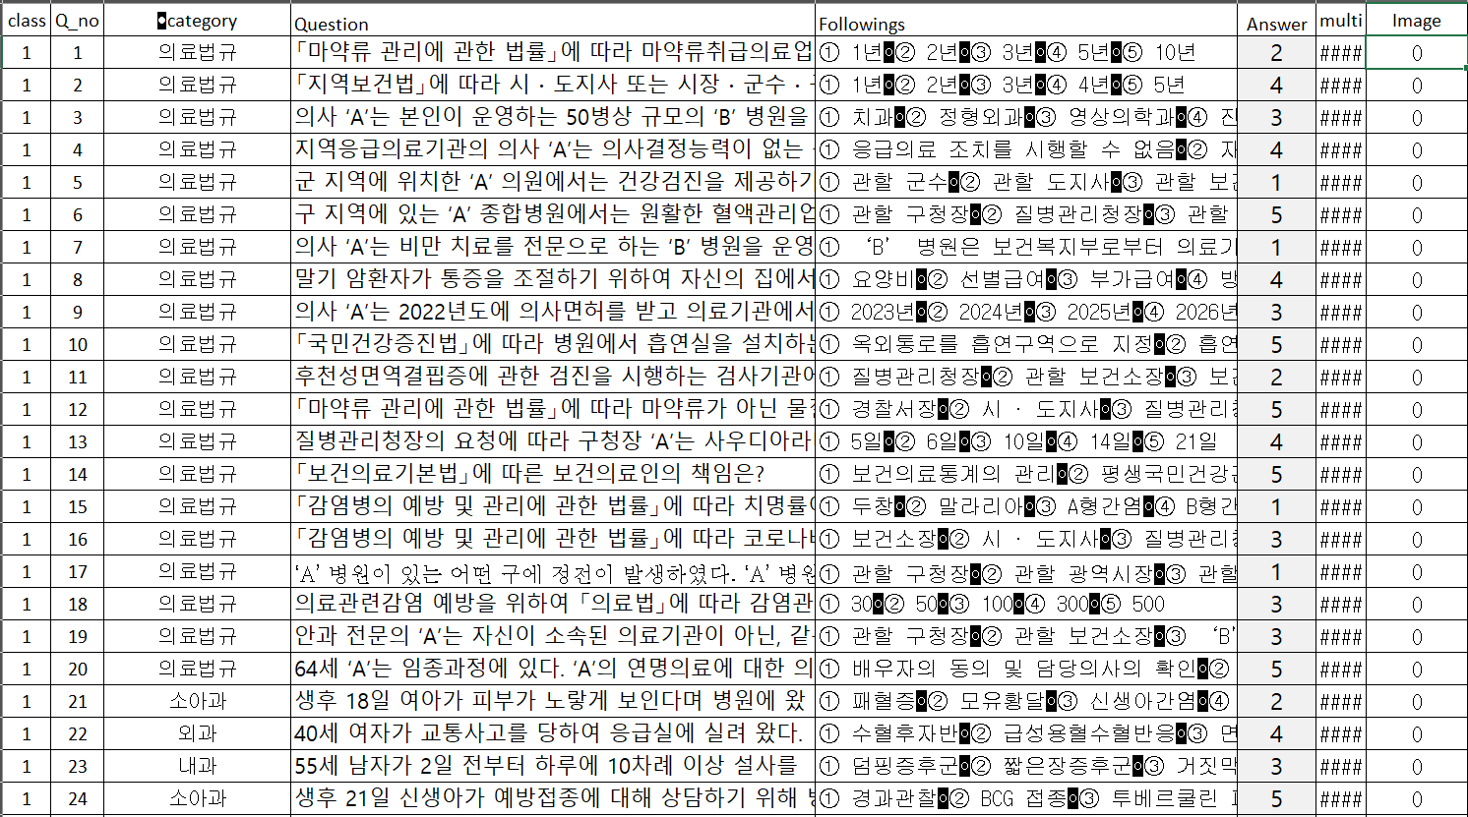
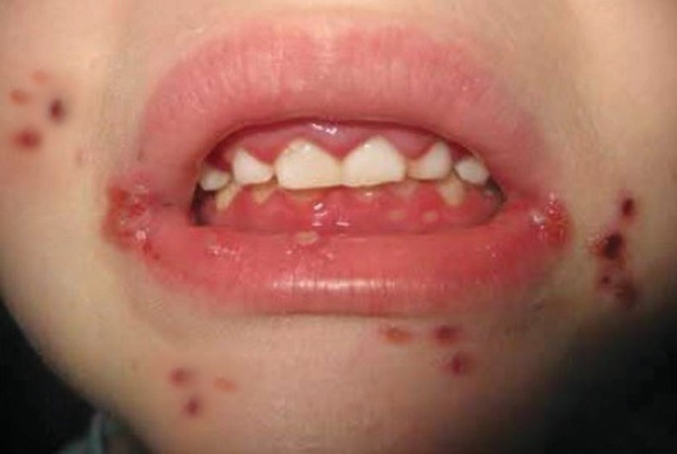
Methods
(Example)
Dataset
2019 ~ 2023 KMLE data
With images
Used only 2021 KMLE data in the datathon.
(Example)
(Question)
5세 남아가 ２시간 전부터 발생한 피부 발진으로 병원에 왔다. 3시간 전에 가족들과 외식을 했고, 식사하고 １시간 후에 몸이 가려워지면서 발진이 나타났다. 체온 36.5℃이다. 피부 사진 (사진 35)이다. 혈액검사 결과는 다음과 같다. 원인 매개체는?
혈색소 13.8 g/dL, 백혈구 9,800/mm3 (중성구 40%, 림프구 52%, 호산구 2%)
1. 보체
2. 히스타민
3. 브라디키닌
4. 인터페론감마
5. 인터루킨-10
Provide both text and image context to GPT-4o
(Choices)

Slide 8
Methods
2021 KMLE exam questions (text + image)
360 questions (185 questions with images)
Workflow
temperature experiments
Extensive
prompting
pipeline
GPT-4o (text + image)
Used default temperature (1.0)
Self-consistency (The most frequent answer to 20 responses.)
Zero shot
With CoT
Zero shot
Without CoT
Zero shot
With CoT
Without images
Evaluate possible bias perpetuated in GPT-4o
CoT: Chain-of-thought

Slide 9
Methods
2021 KMLE exam questions (text + image)
360 questions (185 questions with images)
Workflow
GPT-4o (text + image)
Used default temperature (1.0)
Self-consistency (The most frequent answer to 20 responses.)
Zero shot
With CoT
Zero shot
Without CoT
Zero shot
With CoT
Without images
Evaluate possible bias perpetuated in GPT-4o
Prompt:
You are a Korean medical school student taking the Korean Medical Licensing Examinations to become a Korean doctor.
Answer the questions. Since the correct number of answers to this problem is %d, please provide exactly %d responses.
Elaborate your reasoning before giving the final answer. Think step by step.
Give the answer in the following JSON format
{
"reasoning": "(elaboarate your reasoning here)",
"answer": (answer by number, please provide exactly %d responses)
}
CoT: Chain-of-thought

Slide 10
Methods
Full prompt and response example
Prompt: System content
You are a Korean medical school student taking the Korean Medical Licensing Examinations to become a Korean doctor.
Answer the questions. Since the correct number of answers to this problem is %d, please provide exactly %d responses.
Elaborate your reasoning before giving the final answer. Think step by step.
Give the answer in the following JSON format
{
"reasoning": "(elaboarate your reasoning here)",
"answer": (answer by number, please provide exactly %d responses)
}
Prompt: User content, text
Prompt: User content, image
5세 남아가 ２시간 전부터 발생한 피부 발진으로 병원에 왔다. 3시간 전에 가족들과 외식을 했고, 식사하고 １시간 후에 몸이 가려워지면서 발진이 나타났다. 체온 36.5℃이다. 피부 사진 (사진 35)이다. 혈액검사 결과는 다음과 같다. 원인 매개체는?
혈색소 13.8 g/dL, 백혈구 9,800/mm3 (중성구 40%, 림프구 52%, 호산구 2%)
1. 보체
2. 히스타민
3. 브라디키닌
4. 인터페론감마
5. 인터루킨-10
Response: reasoning
Response: answer
이 환자는 외식 후 1시간 뒤에 몸이 가려워지면서 발진이 나타났습니다. 이는 급성 알레르기 반응을 시사합니다. 알레르기 반응에서 가장 흔히 관련되는 매개체는 히스타민입니다. 히스타민은 알레르기 반응 시 비만세포와 호염구에서 분비되어 혈관 확장, 혈관 투과성 증가, 그리고 가려움증을 유발합니다. 따라서 이 환자의 증상과 관련된 원인 매개체는 히스타민입니다.
2

Slide 11
Methods
2021 KMLE exam questions (text + image)
360 questions (185 questions with images)
Workflow
GPT-4o (text + image)
Used default temperature (1.0)
Self-consistency (The most frequent answer to 20 responses.)
Zero shot
With CoT
Zero shot
Without CoT
Zero shot
With CoT
Without images
Evaluate possible bias perpetuated in GPT-4o
Prompt:
Answer the following question. Give only the answer in the following JSON format
{
"answer": (answer by number, please provide exactly %d responses)
}
CoT: Chain-of-thought

Slide 12
Methods
2021 KMLE exam questions (text + image)
360 questions (185 questions with images)
Workflow
GPT-4o (text + image)
Used default temperature (1.0)
Self-consistency (The most frequent answer to 20 responses.)
Zero shot
With CoT
Zero shot
Without CoT
Zero shot
With CoT
Without images
Evaluate possible bias perpetuated in GPT-4o
Zero shot, with CoT
(Male Korean)
(Female Korean)
(White)
(Black)
(Asian)
Prompt:
You are a ( ) medical school student taking the Korean Medical Licensing Examinations ~~
CoT: Chain-of-thought

Slide 13
Results
Table. GPT-4o accuracy across different temperature settings
Temperature | Accuracy
1.0 | 0.840
0.5 | 0.836
0.0 | 0.839
Temperatures higher than 1.5 resulted in responses that did not adhere to the required format.

Slide 14
Results
Table. GPT-4o accuracy across different temperature settings
Temperature | Accuracy
1.0 | 0.840
0.5 | 0.836
0.0 | 0.839
Used the default temperature for the experiments
Temperatures higher than 1.5 resulted in responses that did not adhere to the required format.

Slide 15
Results
Table. GPT-4o accuracy comparison on a subset of questions with images (185 questions)
Table. GPT-4o accuracy comparison between scenarios
Scenario | Accuracy | p-value
Zeroshot, CoT | 0.838 | Ref.
Zeroshot, No CoT | 0.737 | < 0.001 ***
Zeroshot, CoT, No image | 0.812 | 0.007 **
Zeroshot, CoT, Male | 0.831 | 0.165
Zeroshot, CoT, Female | 0.829 | 0.048 *
Zeroshot, CoT, White | 0.833 | 0.338
Zeroshot, CoT, Black | 0.832 | 0.200
Zeroshot, CoT, Asian | 0.832 | 0.133
 | CoT, with images | CoT, without images
Correct | 153 | 140
Incorrect | 32 | 45
Accuracy
= 0.827
Accuracy
= 0.757
p-value = 0.096
(marginal significance)
*p<0.05, **p<0.01, ***p<0.001
CoT: Chain of thought
Consistency of GPT-4o across 20 responses: 0.838 $±$ 0.318

Slide 16
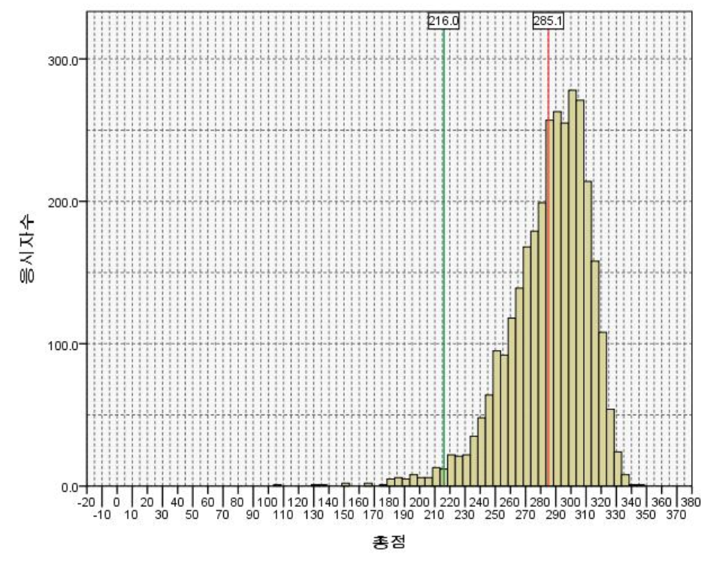
Results
Table. GPT-4o accuracy comparison between scenarios
Scenario | Accuracy | p-value
Zeroshot, CoT | 0.838 | Ref.
Zeroshot, No CoT | 0.737 | < 0.001 ***
Zeroshot, CoT, No image | 0.812 | 0.007 **
Zeroshot, CoT, Male | 0.831 | 0.165
Zeroshot, CoT, Female | 0.829 | 0.048 *
Zeroshot, CoT, White | 0.833 | 0.338
Zeroshot, CoT, Black | 0.832 | 0.200
Zeroshot, CoT, Asian | 0.832 | 0.133
Average score = 0.792
*p<0.05, **p<0.01, ***p<0.001
CoT: Chain of thought
Figure. Score distribution of actual test-takers
Consistency of GPT-4o across 20 responses: 0.838 $±$ 0.318

Slide 17
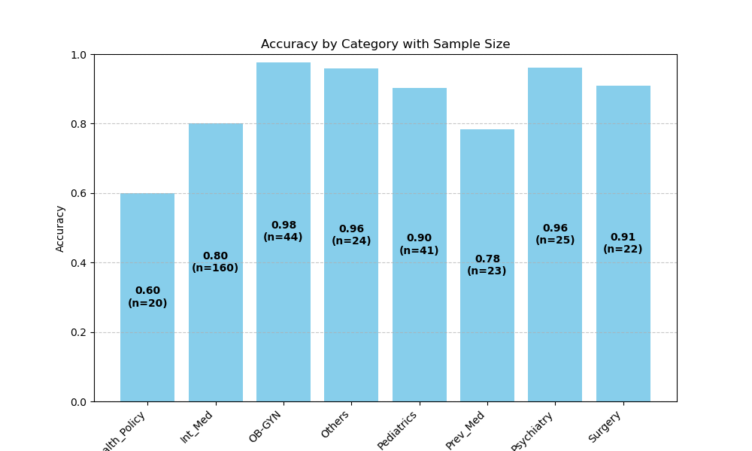
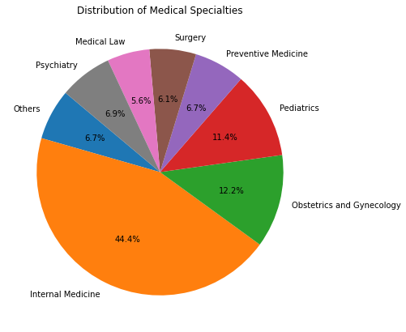
Results
OBG & GYN
health
Figure. GPT-4o accuracy per subject (zero shot, CoT)

Slide 18
Results
OBG & GYN
health
Figure. GPT-4o accuracy per subject (zero shot, CoT)

Slide 19
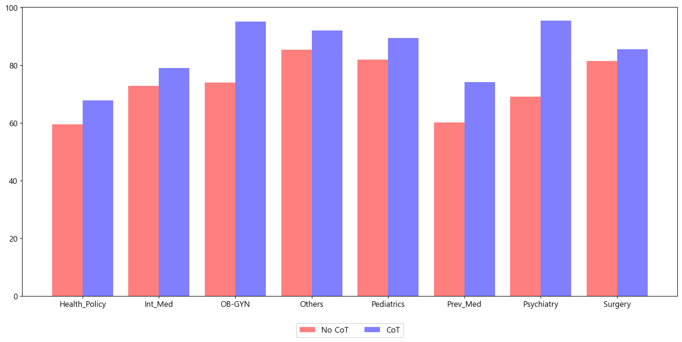
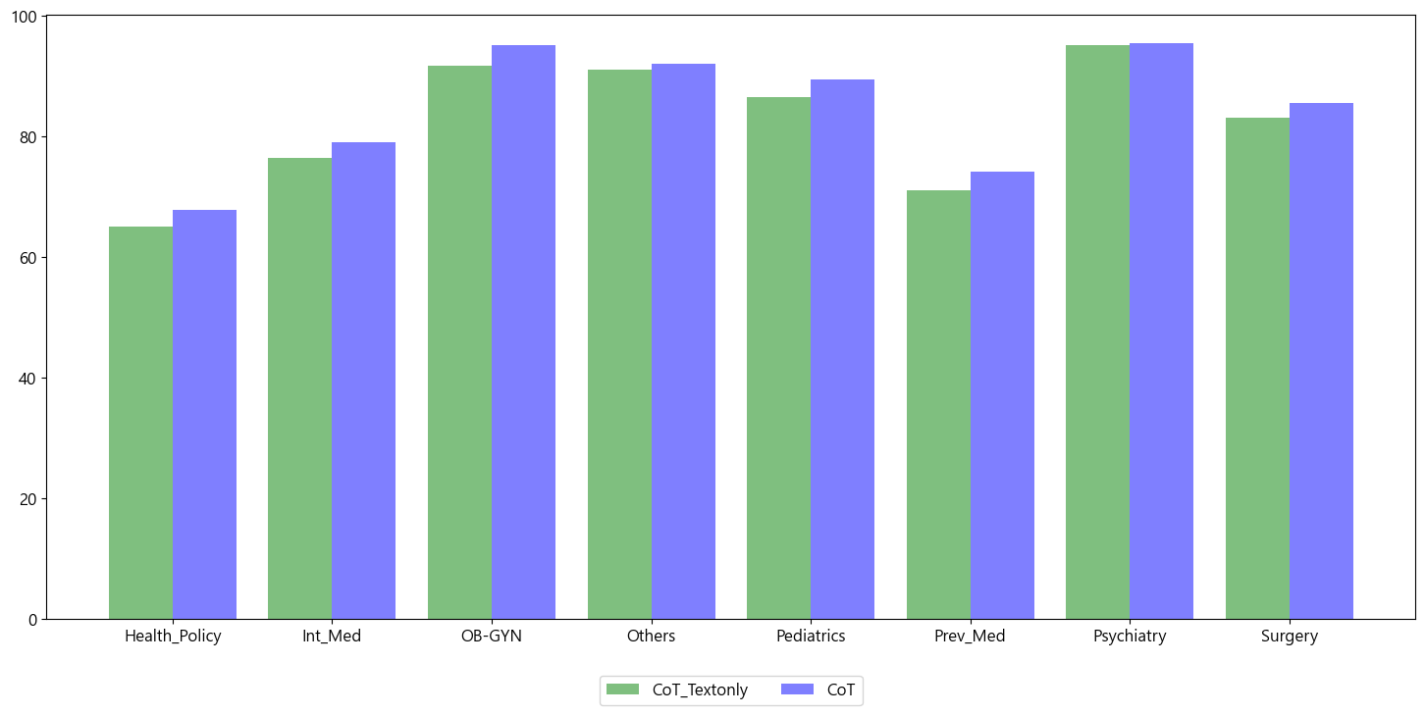
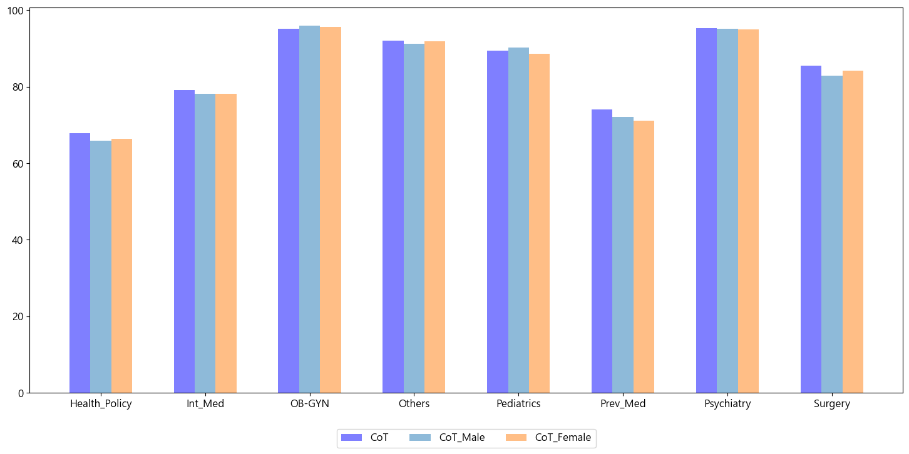
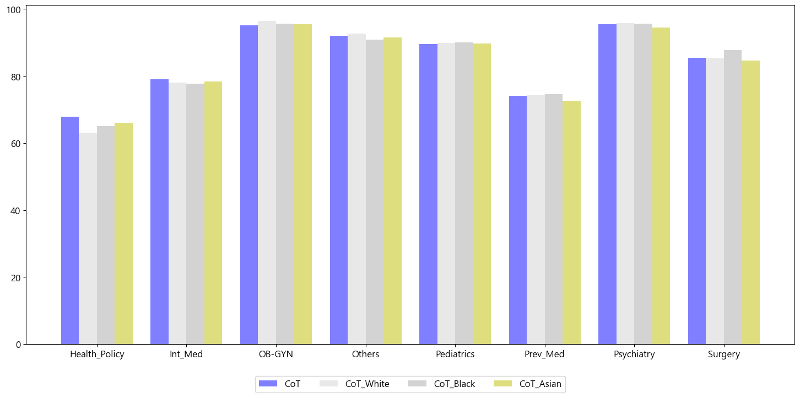
Results
Figure. Comparison of “CoT” vs “no CoT” accuracy per subject
Figure. Comparison of “Images” vs “no images” accuracy per subject
Figure. Comparison across sexes per subject
Figure. Comparison across different races/ethnicities per subject

Slide 20
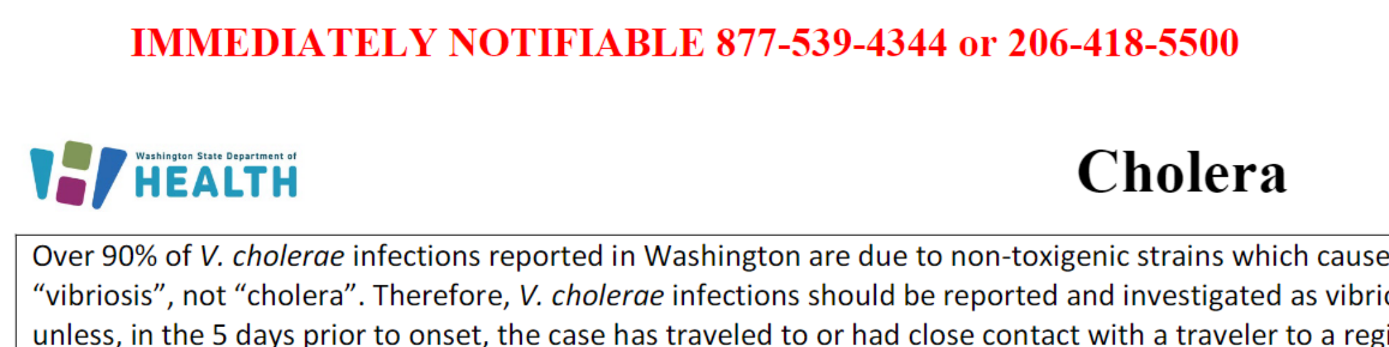
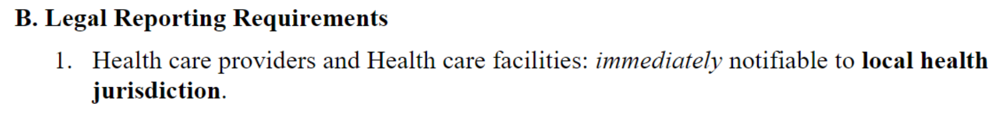
Results
Example of an incorrect GPT-4o response in the “health policy” subject
Example of an incorrect GPT-4o response that might have been caused by different laws across countries.
Question: 콜레라에 걸리면 의사는 어디에 신고해야하는가? (Where should a doctor report if someone contracts cholera?)
Correct answer in KMLE (Korean law): 소속 의료기관의 장 (Head of the affiliated medical institution)
GPT-4o response: 관할 보건소장 (Head of the local health center)
US Law: Local health jurisdiction

Slide 21

Example of an incorrect GPT-4o response in the “preventive medicine” subject
73. Smoking was investigated in 70 patients with myocardial infarction and 70 control subjects without any special diseases. The control group was selected through individual pairing with the same key variables as the myocardial infarction patients. What is the odds ratio?
Comparison
Smoking Nonsmoking
Patients Smoking 10 20
Nonsmoking 10 30
① 0.08
② 0.25
③ 1.3
④ 1.5
⑤ 2.0
GPT’s reasoning
To determine the odds ratio (OR), we need to first construct a 2x2 contingency table with the given data. The table can be arranged as follows: Case (MI) Control (No MI) Smokers 10 20 Non-Smokers 10 30 The formula for the odds ratio is: OR = (a/c) / (b/d) = (10/10) / (20/30) Simplifying the fraction: OR = 1 / (2/3) = 1 * (3/2) = 3/2 = 1.5 Thus, the correct answer is 1.5.
Incorrect understanding of the task
Because the example in question paired data from the patient group and the control group, the general odds ratio calculation formula cannot be applied. Therefore, applying the paired odds ratio calculation formula, 𝑂𝑅_𝑝𝑎𝑖𝑟𝑒𝑑=20/10=2.0.

Slide 22
Discussion
GPT-4o achieved an accuracy of 0.838 on the KMLE using both text and image data
Questions were provided in Korean.
Providing images compared to providing text only improved accuracy, with marginal statistical significance
Even when the test-taker's sex and race/ethnicity were set differently as instructions to GPT-4o, no bias was observed.
Accuracy was low in the following subjects
“Health policy”: Different laws across countries?
“Preventive medicine”: difficult task for GPT-4o
Well-known prompting stratigies such as CoT was indeed necessary.

Slide 23
Discussion
Future plans
Manuscript?
Few shot prompting
Comparison with other local-version models (ex. Bllossom/llama-3-Korean-Bllossom-70B)
Rotation, blurring, etc of images?
Better prompting strategy to guide GPT-4o to refer to images more effectively?
Other MLEs. (ex. USMLE)
More years (ex. 2020~2023)

Slide 24
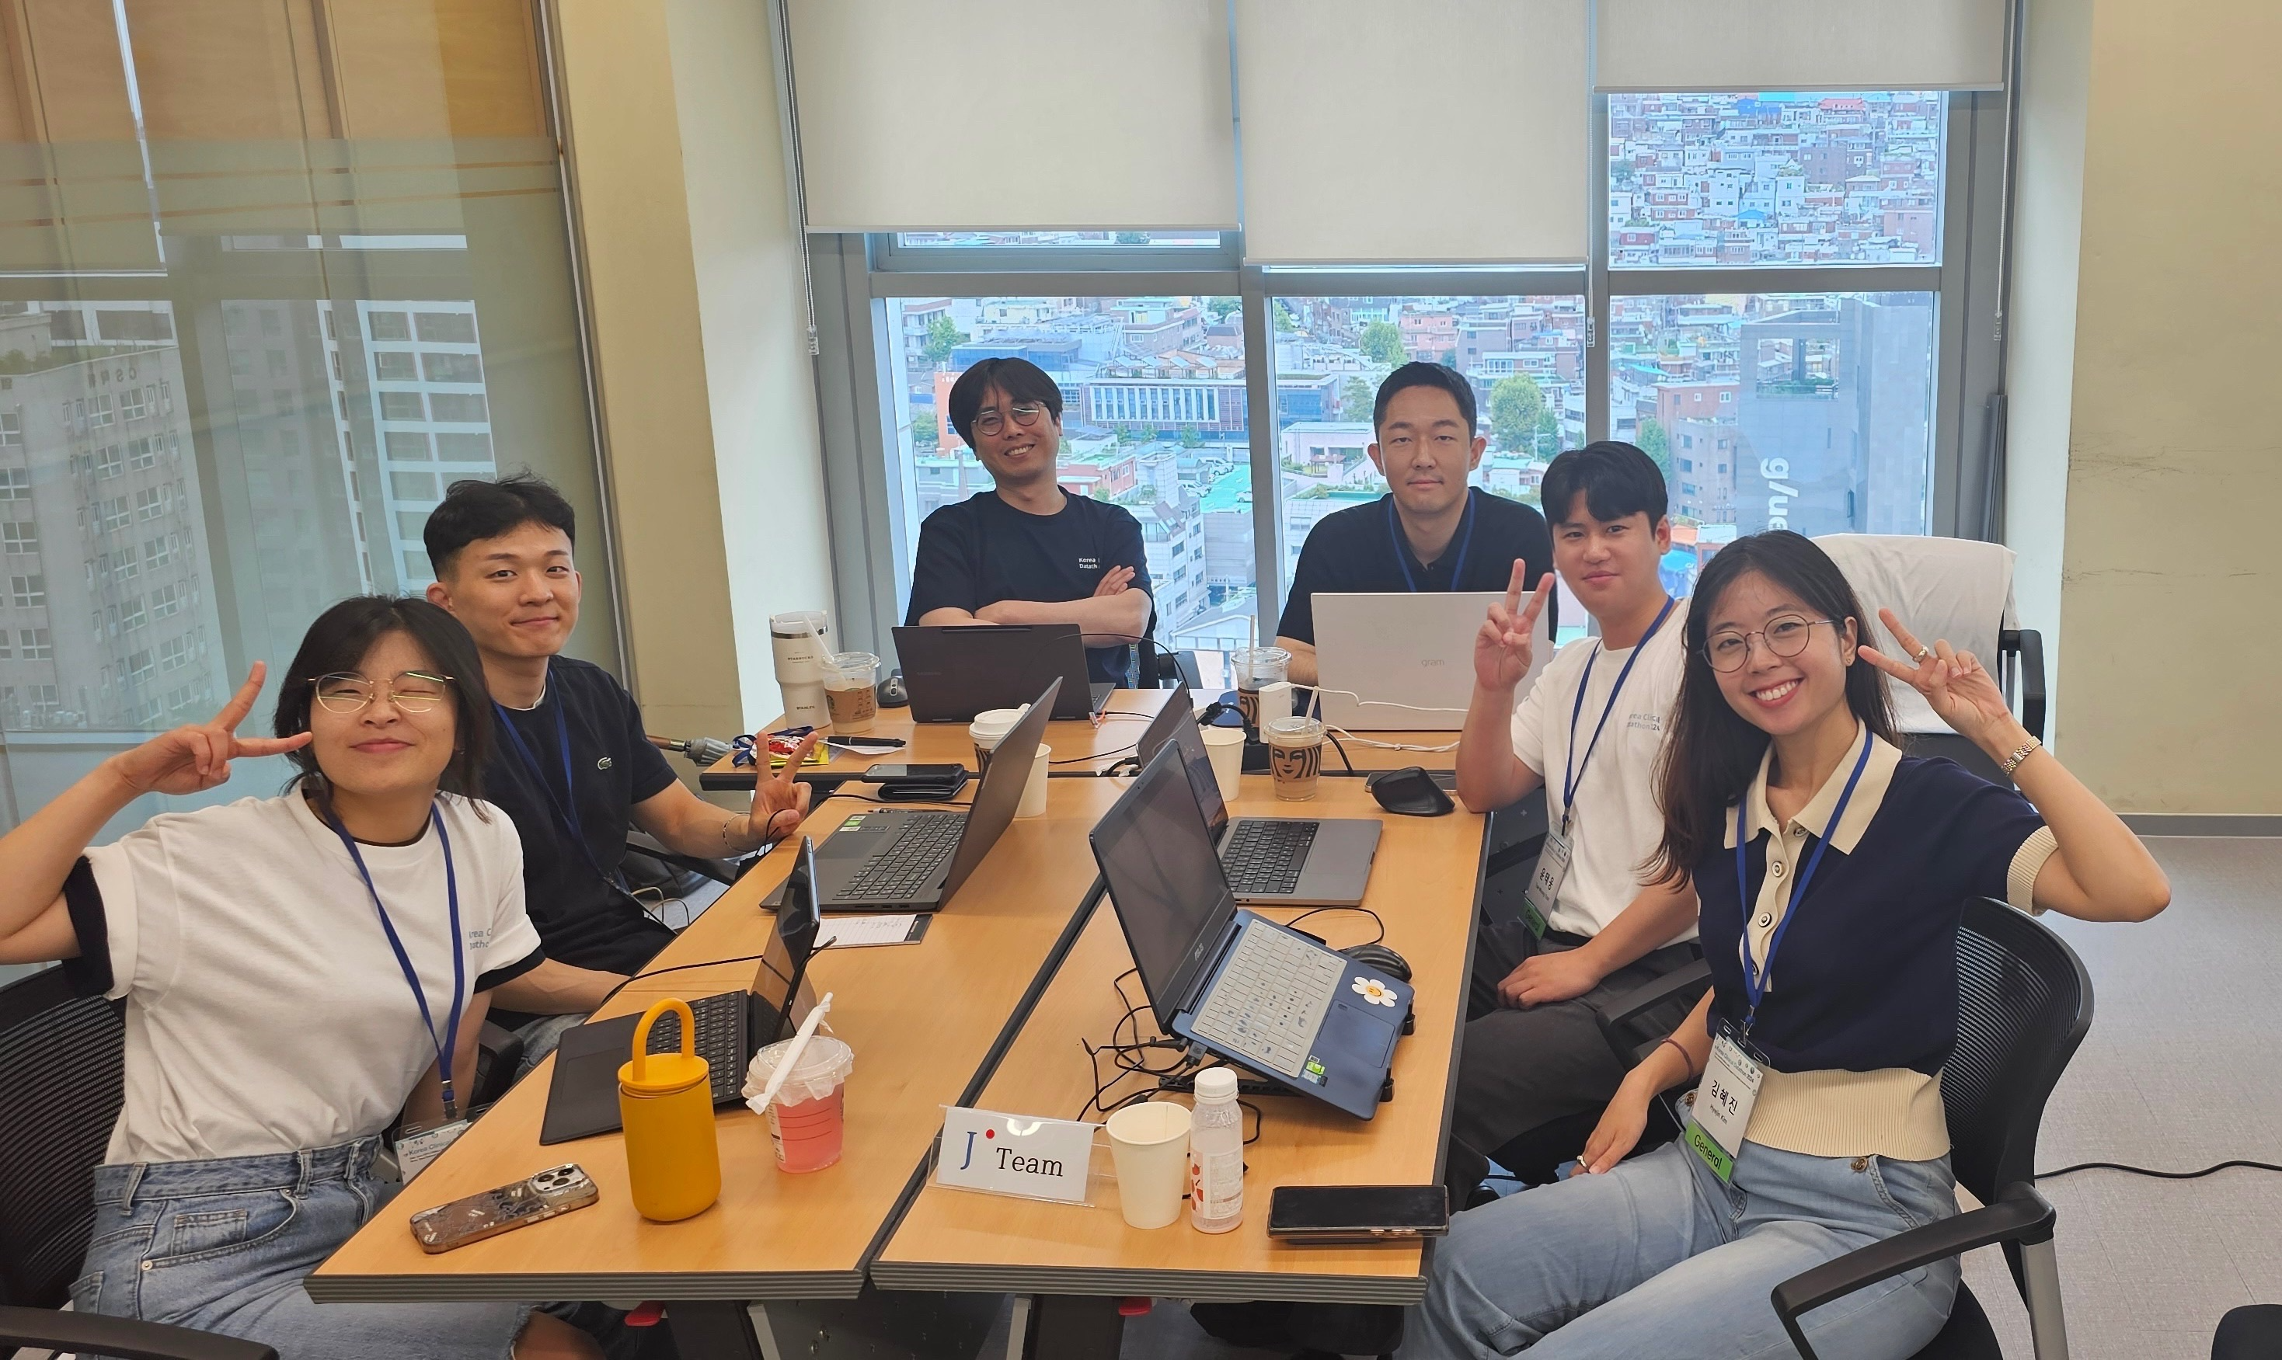
Collaboration
김혜진, Hyejin Kim | Ideation (bias evaluation), post-hoc analysis (statistical analysis, visualization)
윤준, Jun Yoon | Ideation, GPT-4o accuracy evaluation pipeline, post-hoc analysis
윤진식, Jinsik Yoon | Data analysis leader, GPT-4o prompting pipeline implementation
윤태웅, Taewoong Yoon | Ideation, post-hoc analysis (scenario comparison, visualization)
장보아, Boa Jang | Ideation, data preprocessing, post-hoc analysis (statistical analysis, visualization)
한창호, Changho Han | Team leader, provide GPT-4o prompting pipeline
Jinsik Yoon
Changho Han
Hyejin Kim | hyejinpsych@yuhs.ac
Jun Yoon | ynjoon@naver.com
Jinsik Yoon | jsyoon0128@yuhs.ac
Taewoong Yoon | taewoong816@gmail.com
Boa Jang | boajang97@gmail.com
Changho Han | changhohan8142@gmail.com
Jun Yoon
Taewoong Yoon
Boa Jang
Hyejin Kim

Slide 25
Thank You

